Slide 1
DATA MINING LECTURE 3
Frequent Itemsets
Association Rules

Slide 2
This is how it all started…
Rakesh Agrawal, Tomasz Imielinski, Arun N. Swami: Mining Association Rules between Sets of Items in Large Databases. SIGMOD Conference 1993: 207-216
Rakesh Agrawal, Ramakrishnan Srikant: Fast Algorithms for Mining Association Rules in Large Databases. VLDB 1994: 487-499
These two papers are credited with the birth of Data Mining
For a long time people were fascinated with Association Rules and Frequent Itemsets
Some people (in industry and academia) still are.

Slide 3
Market-Basket Data
A large set of items, e.g., things sold in a supermarket.
A large set of baskets, each of which is a small set of the items, e.g., the things one customer buys on one day.

Slide 4
Market-Baskets – (2)
Really, a general many-to-many mapping (association) between two kinds of things, where the one (the baskets) is a set of the other (the items)
But we ask about connections among “items,” not “baskets.”

Slide 5
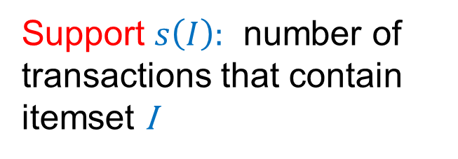

Frequent Itemsets
Given a set of transactions, find combinations of items (itemsets) that occur frequently
Support $s\left(I\right)$: number of transactions that contain itemset I
Market-Basket transactions
Items: {Bread, Milk, Diaper, Beer, Eggs, Coke}
Examples of frequent itemsets $s\left(I\right)$ ≥ 3
{Bread}: 4
{Milk} : 4
{Diaper} : 4
{Beer}: 3
{Diaper, Beer} : 3 {Milk, Bread} : 3
Notes:
5

Slide 6
Applications – (1)
Items = products; baskets = sets of products someone bought in one trip to the store.
Example application: given that many people buy beer and diapers together:
Run a sale on diapers; raise price of beer.
Only useful if many buy diapers & beer.

Slide 7
Applications – (2)
Baskets = Web pages; items = words.
Example application: Unusual words appearing together in a large number of documents, e.g., “Brad” and “Angelina,” may indicate an interesting relationship.

Slide 8
Applications – (3)
Baskets = sentences; items = documents containing those sentences.
Example application: Items that appear together too often could represent plagiarism.
Notice items do not have to be “in” baskets.

Slide 9
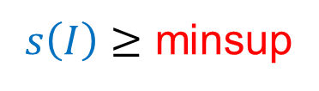
Definition: Frequent Itemset
Itemset
A collection of one or more items
Example: {Milk, Bread, Diaper}
k-itemset
An itemset that contains k items
Support (σ)
Count: Frequency of occurrence of an itemset
E.g. σ({Milk, Bread,Diaper}) = 2
Fraction: Fraction of transactions that contain an itemset
E.g. s({Milk, Bread, Diaper}) = 40%
Frequent Itemset
An itemset whose support is greater than or equal to a minsup threshold
$s\left(I\right)≥$ minsup

Slide 10
Mining Frequent Itemsets task
Input: A set of transactions T, over a set of items I
Output: All itemsets with items in I having
support ≥ minsup threshold
Problem parameters:
N = |T|: number of transactions
d = |I|: number of (distinct) items
w: max width of a transaction
Number of possible itemsets?
Scale of the problem:
WalMart sells 100,000 items and can store billions of baskets.
The Web has billions of words and many billions of pages.
M = 2^{d}

Slide 11
The itemset lattice
Given d items, there are 2^{d} possible itemsets

Slide 12
A Naïve Algorithm
Brute-force approach, each itemset is a candidate :
Consider each itemset in the lattice, and count the support of each candidate by scanning the data
Time Complexity ~ O(NMw) , Space Complexity ~ O(M)
OR
Scan the data, and for each transaction generate all possible itemsets. Keep a count for each itemset in the data.
Time Complexity ~ O(N2^{w}) , Space Complexity ~ O(M)
Expensive since M = 2^{d} !!!

Slide 13
Example file: retail
0 1 2 3 4 5 6 7 8 9 10 11 12 13 14 15 16 17 18 19 20 21 22 23 24 25 26 27 28 29
30 31 32
33 34 35
36 37 38 39 40 41 42 43 44 45 46
38 39 47 48
38 39 48 49 50 51 52 53 54 55 56 57 58
32 41 59 60 61 62
3 39 48
63 64 65 66 67 68
32 69
48 70 71 72
39 73 74 75 76 77 78 79
36 38 39 41 48 79 80 81
82 83 84
41 85 86 87 88
39 48 89 90 91 92 93 94 95 96 97 98 99 100 101
36 38 39 48 89
39 41 102 103 104 105 106 107 108
38 39 41 109 110
39 111 112 113 114 115 116 117 118
119 120 121 122 123 124 125 126 127 128 129 130 131 132 133
48 134 135 136
39 48 137 138 139 140 141 142 143 144 145 146 147 148 149
39 150 151 152
38 39 56 153 154 155
Example: items are
positive integers,
and each basket corresponds to a line in the file of space separated integers

Slide 14
Main-Memory Bottleneck
For many frequent-itemset algorithms, main memory is the critical resource.
As we read baskets, we need to count something, e.g., occurrences of pairs.
The number of different things we can count is limited by main memory.
Swapping counts in/out is a disaster (why?).

Slide 15
The Apriori Principle
Apriori principle (Main observation):
If an itemset is frequent, then all of its subsets must also be frequent
If an itemset is not frequent, then all of its supersets cannot be frequent
The support of an itemset never exceeds the support of its subsets
This is known as the anti-monotone property of support
Notes:
15

Slide 16
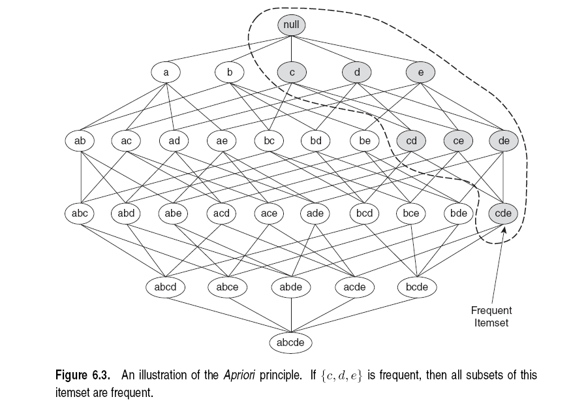
Illustration of the Apriori principle
Frequent subsets
Found to be frequent

Slide 17
Illustration of the Apriori principle
Found to be Infrequent
Infrequent supersets
Pruned

Slide 18
The Apriori algorithm
C_{k} = candidate itemsets of size k
L_{k} = frequent itemsets of size k
Level-wise approach
k = 1, C₁ = all items
While C_{k} not empty
Scan the database to find which itemsets in C_{k} are frequent and put them into L_{k}
Use L_{k} to generate a collection of candidate itemsets C_{k+1} of size k+1‏
k = k+1
Frequent itemset generation
Candidate generation
R. Agrawal, R. Srikant: "Fast Algorithms for Mining Association Rules",
Proc. of the 20th Int'l Conference on Very Large Databases, 1994.
Notes:
18

Slide 19
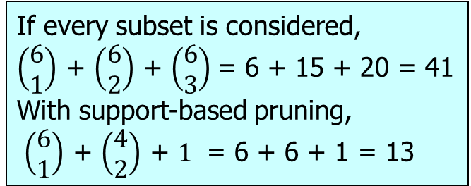
Illustration of the Apriori principle
minsup = 3
Items (1-itemsets)‏
Pairs (2-itemsets)‏
(No need to generate candidates involving Coke or Eggs)‏
Triplets (3-itemsets)‏
If every subset is considered,
$\left(\begin{matrix}6 \\ 1\end{matrix}\right)$ + $\left(\begin{matrix}6 \\ 2\end{matrix}\right)$ + $\left(\begin{matrix}6 \\ 3\end{matrix}\right)$= 6 + 15 + 20 = 41
With support-based pruning,
$\left(\begin{matrix}6 \\ 1\end{matrix}\right)$ + $\left(\begin{matrix}4 \\ 2\end{matrix}\right)$ + $1$ = 6 + 6 + 1 = 13
Only this triplet has all subsets to be frequent
But it is below the minsup threshold
Notes:
19

Slide 20
Candidate Generation
Basic principle (Apriori):
An itemset of size k+1 is candidate to be frequent only if all of its subsets of size k are known to be frequent
Main idea:
Construct a candidate of size k+1 by combining frequent itemsets of size k
If k = 1, take the all pairs of frequent items
If k > 1, join pairs of itemsets that differ by just one item
For each generated candidate itemset ensure that all subsets of size k are frequent.

Slide 21
Generate Candidates C_{k+1}
Assumption: The items in an itemset are ordered
E.g., if integers ordered in increasing order, if strings ordered in lexicographic order
The order ensures that if item y > x appears before x, then x is not in the itemset
The items in L_{k} are also listed in an order
Create a candidate itemset of size k+1, by joining two itemsets of size k, that share the first k-1 items
Item 1 | Item 2 | Item 3
1 | 2 | 3
1 | 2 | 5
1 | 4 | 5
Notes:
21

Slide 22
Generate Candidates C_{k+1}
Assumption: The items in an itemset are ordered
E.g., if integers ordered in increasing order, if strings ordered in lexicographic order
The order ensures that if item y > x appears before x, then x is not in the itemset
The items in L_{k} are also listed in an order
Create a candidate itemset of size k+1, by joining two itemsets of size k, that share the first k-1 items
Item 1 | Item 2 | Item 3
1 | 2 | 3
1 | 2 | 5
1 | 4 | 5
1 | 2 | 3 | 5
Notes:
22

Slide 23
Generate Candidates C_{k+1}
Assumption: The items in an itemset are ordered
E.g., if integers ordered in increasing order, if strings ordered in lexicographic order
The order ensures that if item y > x appears before x, then x is not in the itemset
The items in L_{k} are also listed in an order
Create a candidate itemset of size k+1, by joining two itemsets of size k, that share the first k-1 items
Item 1 | Item 2 | Item 3
1 | 2 | 3
1 | 2 | 5
1 | 4 | 5
Are we missing something?
What about this candidate?
1 | 2 | 4 | 5
Notes:
23

Slide 24
Generating Candidates C_{k+1} in SQL
self-join L_{k} ‏
insert into C_{k+1}
select p.item₁, p.item₂, …, p.item_{k}, q.item_{k}
from L_{k} p, L_{k} q
where p.item₁=q.item₁, …, p.item_{k-1}=q.item_{k-1}, p.item_{k} < q.item_{k}

Slide 25
Example I
L₃={abc, abd, acd, ace, bcd}
Self-joining: L₃*L₃
abcd from abc and abd
acde from acd and ace
item1 | item2 | item3
a | b | c
a | b | d
a | c | d
a | c | e
b | c | d
item1 | item2 | item3
a | b | c
a | b | d
a | c | d
a | c | e
b | c | d
p.item₁=q.item₁,p.item₂=q.item₂, p.item₃< q.item₃
Notes:
25

Slide 26
Example I
L₃={abc, abd, acd, ace, bcd}
Self-joining: L₃*L₃
abcd from abc and abd
acde from acd and ace
item1 | item2 | item3
a | b | c
a | b | d
a | c | d
a | c | e
b | c | d
item1 | item2 | item3
a | b | c
a | b | d
a | c | d
a | c | e
b | c | d
p.item₁=q.item₁,p.item₂=q.item₂, p.item₃< q.item₃
Notes:
26

Slide 27
Example I
L₃={abc, abd, acd, ace, bcd}
Self-joining: L₃*L₃
abcd from abc and abd
acde from acd and ace
item1 | item2 | item3
a | b | c
a | b | d
a | c | d
a | c | e
b | c | d
item1 | item2 | item3
a | b | c
a | b | d
a | c | d
a | c | e
b | c | d
{a,b,c}
{a,b,d}
{a,b,c,d}
p.item₁=q.item₁,p.item₂=q.item₂, p.item₃< q.item₃
Notes:
27

Slide 28
Example I
L₃={abc, abd, acd, ace, bcd}
Self-joining: L₃*L₃
abcd from abc and abd
acde from acd and ace
item1 | item2 | item3
a | b | c
a | b | d
a | c | d
a | c | e
b | c | d
item1 | item2 | item3
a | b | c
a | b | d
a | c | d
a | c | e
b | c | d
{a,c,d}
{a,c,e}
{a,c,d,e}
p.item₁=q.item₁,p.item₂=q.item₂, p.item₃< q.item₃
Notes:
28

Slide 29
Example II
{Bread,Diaper}
√
{Bread,Milk}
√
{Diaper, Milk}
√

Slide 30
Generate Candidates C_{k+1}
Are we done? Are all the candidates valid?
Pruning step:
For each candidate (k+1)-itemset create all subset k-itemsets
Remove a candidate if it contains a subset k-itemset that is not frequent
Item 1 | Item 2 | Item 3
1 | 2 | 3
1 | 2 | 5
1 | 4 | 5
1 | 2 | 3 | 5
Is this a valid candidate?
No. Subsets (1,3,5) and (2,3,5) should also be frequent
Apriori principle

Slide 31
Example I
{a,b,c}
{a,b,d}
L₃={abc, abd, acd, ace, bcd}
Self-joining: L₃*L₃
abcd from abc and abd
acde from acd and ace
Pruning:
abcd is kept since all subset itemsets are in L₃
acde is removed because ade is not in L₃
C₄={abcd}
{a,b,c,d}
abc
abd
acd
bcd
√
√
√
√
{a,c,d}
{a,c,e}
{a,c,d,e}
acd
ace
ade
cde
√
√
X
Notes:
31

Slide 32
Generate Candidates C_{k+1}
We have all frequent k-itemsets L_{k}
Step 1: self-join L_{k}‏
Create set C_{k+1} by joining frequent k-itemsets that share the first k-1 items
Step 2: prune
Remove from C_{k+1} the itemsets that contain a subset k-itemset that is not frequent
Notes:
32

Slide 33
Count
the items
All pairs
of items
from L₁
Count
the pairs
All
items
Filter
Construct
Filter
Construct
C₁
L₁
C₂
L₂
C₃
First
pass
Second
pass
Frequent
items
Frequent
pairs

Slide 34
ASSOCIATION RULES

Slide 35
Association Rule Mining
Given a set of transactions, find rules that will predict the occurrence of an item based on the occurrences of other items in the transaction
Market-Basket transactions
Example of Association Rules
{Diaper} → {Beer}, {Milk, Bread} → {Eggs,Coke}, {Beer, Bread} → {Milk},
Implication means co-occurrence, not causality!

Slide 36
Definition: Association Rule
Association Rule
An implication expression of the form X → Y, where X and Y are itemsets
Example: {Milk, Diaper} → {Beer}
Rule Evaluation Metrics
Support (s)
Fraction of transactions that contain both X and Y
the probability P(X,Y) that X and Y occur together
Confidence (c)
Measures how often items in Y appear in transactions that contain X
the conditional probability P(Y|X) that Y occurs given that X has occurred.
Example:

Slide 37
Association Rule Mining Task
Input: A set of transactions T, over a set of items I
Output: All rules with items in I having
support ≥ minsup threshold
confidence ≥ minconf threshold

Slide 38
Mining Association Rules
Two-step approach:
Frequent Itemset Generation
Generate all itemsets whose support ≥ minsup
Rule Generation
Generate high confidence rules from each frequent itemset, where each rule is a partitioning of a frequent itemset into Left-Hand-Side (LHS) and Right-Hand-Side (RHS)
Frequent itemset: {A,B,C,D}
Rule: AB→CD

Slide 39
Rule Generation
We have all frequent itemsets, how do we get the rules?
For every frequent itemset S, we find rules of the form L → S – L , where L ⊂ S, that satisfy the minimum confidence requirement
Example: L = {A,B,C,D}
Candidate rules:
A →BCD, B →ACD, C →ABD, D →ABC AB →CD, AC → BD, AD → BC, BD →AC, CD →AB, ABC →D, BCD →A, BC →AD,
If |L| = k, then there are 2^{k} – 2 candidate association rules (ignoring L → ∅ and ∅ → L)

Slide 40
Rule Generation
How to efficiently generate rules from frequent itemsets?
In general, confidence does not have an anti-monotone property
c(ABC →D) can be larger or smaller than c(AB →D)
But confidence of rules generated from the same itemset has an anti-monotone property
e.g., L = {A,B,C,D}: c(ABC → D) ≥ c(AB → CD) ≥ c(A → BCD)
Confidence is anti-monotone w.r.t. number of items on the RHS of the rule

Slide 41
Rule Generation for Apriori Algorithm
Low Confidence Rule
Pruned Rules
Lattice of rules created by the RHS

